Slide 1
Essential Elements of VR Headsets:
A Technical Overview

Slide 2
CONTENT
NO.1
Introduction
NO.2
Hardware
Optics
Displays
Tracking
Chipsets
NO.3
Conclusion

Slide 3
1

Slide 4
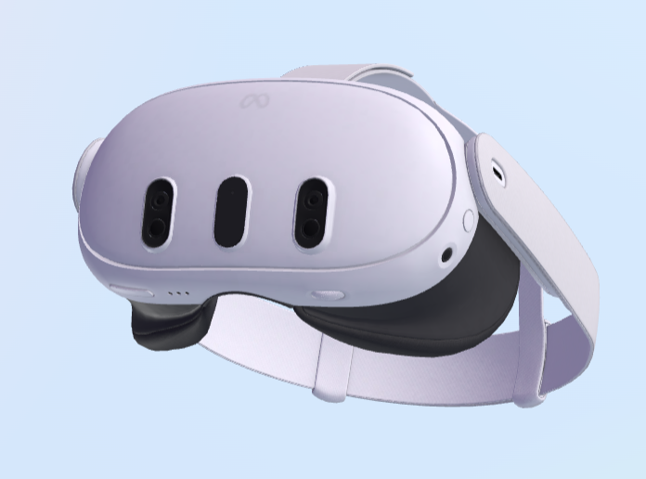
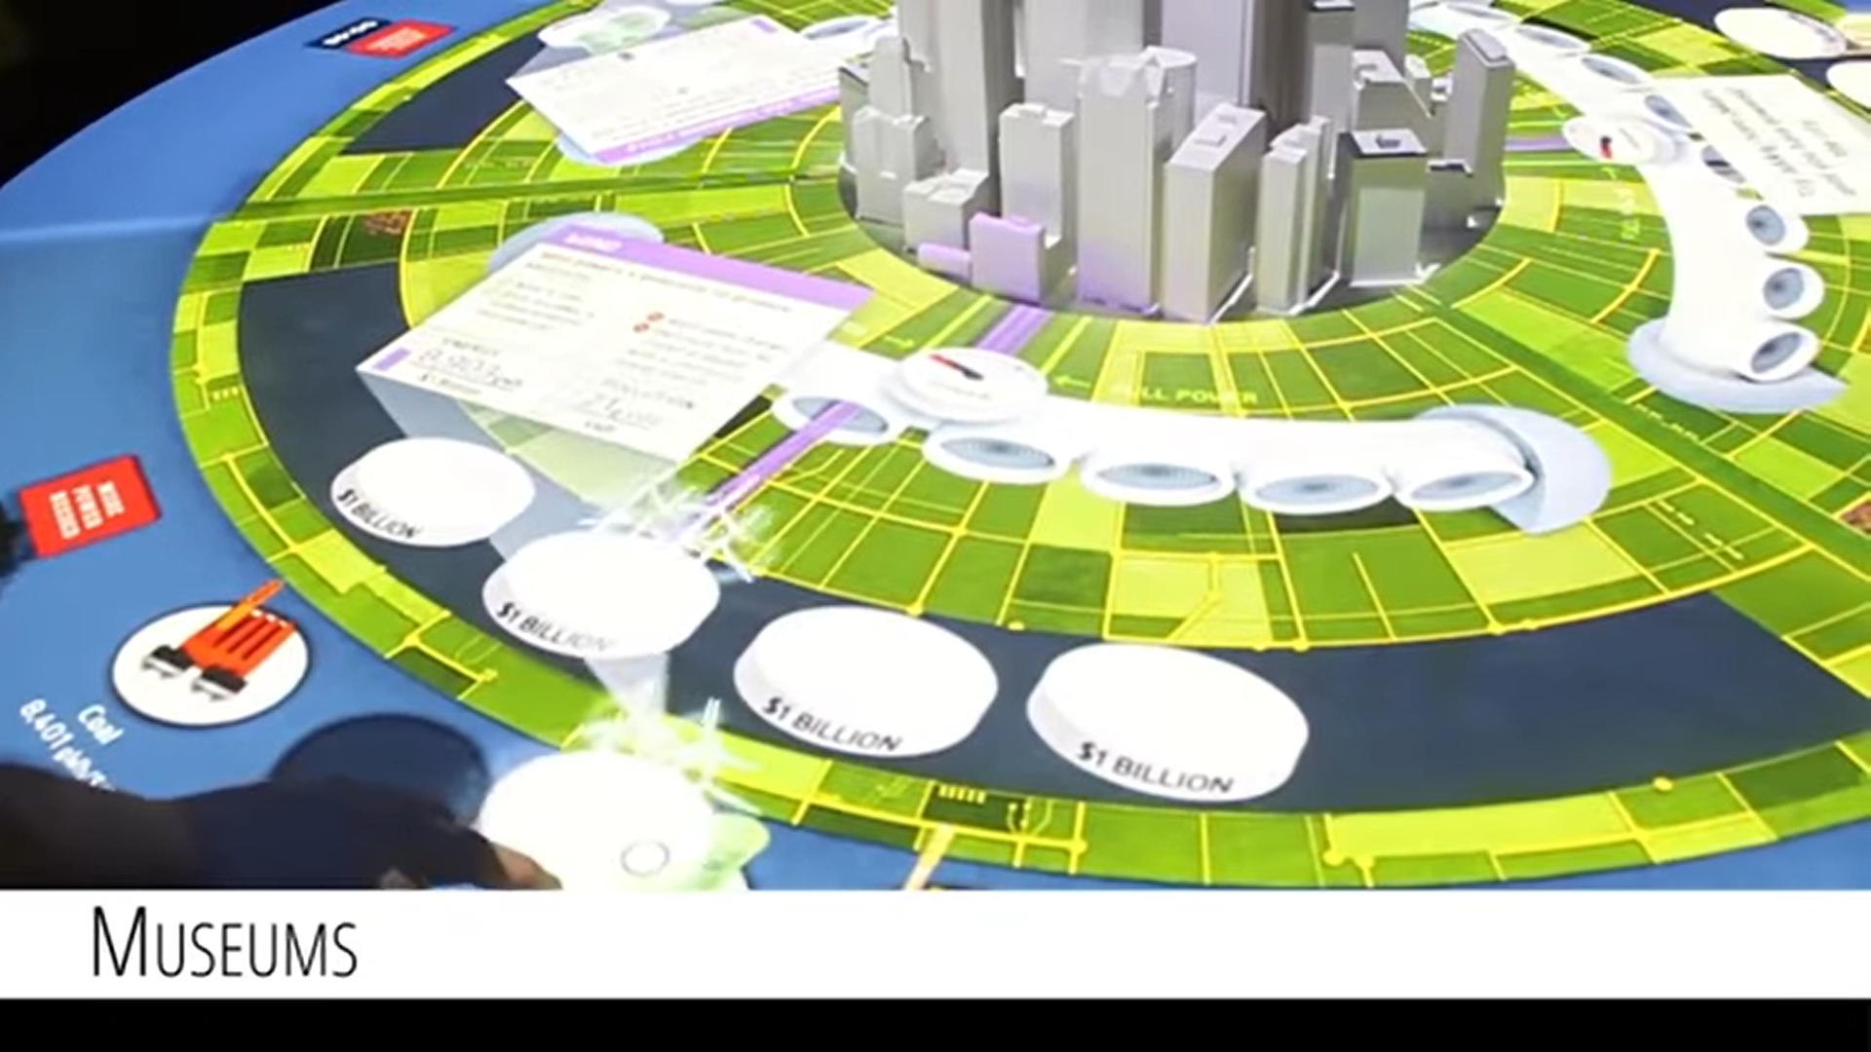
Introduction
There are many types of XR devices[1].
Head-Mounted-Display (HMD)
Spatial Augmented Reality (SAR)
[1] A Comparison of Immersive Realities and Interaction Methods: Cultural Learning in Virtual Heritage, 2019
Notes:
There are many XR devices. Five types: Head-Mounted-Display (HMD), Spatial Augmented Reality (SAR), Hand-Held-Devices (HHD), desktop screen and projection, and Cave Automatic Virtual Environment (CAVE).

Slide 5

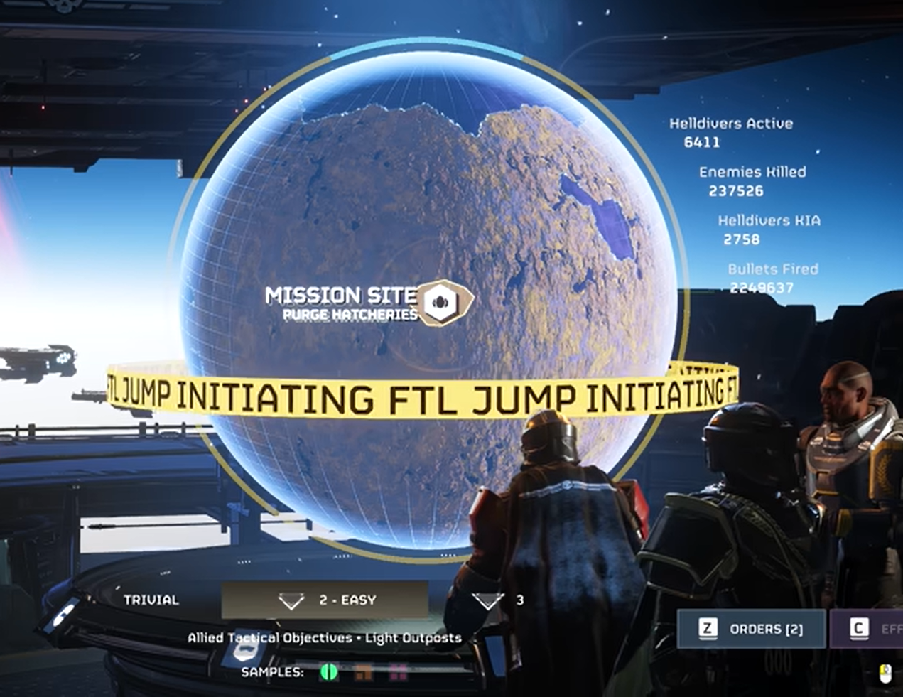
Introduction
There are many types of XR devices[1].
Hand-Held-Devices (HHD)
desktop screen and projection
[1] A Comparison of Immersive Realities and Interaction Methods: Cultural Learning in Virtual Heritage, 2019
Notes:
There are many XR devices. Five types: Head-Mounted-Display (HMD), Spatial Augmented Reality (SAR), Hand-Held-Devices (HHD), desktop screen and projection, and Cave Automatic Virtual Environment (CAVE).

Slide 6
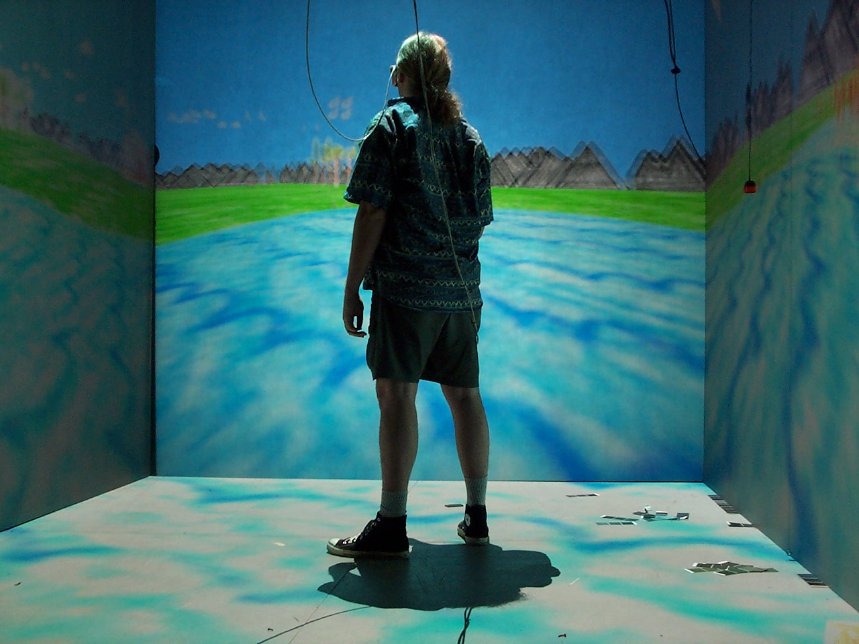
Introduction
Cave Automatic Virtual Environment (CAVE)
Notes:
Cave Automatic Virtual Environment (CAVE).

Slide 7
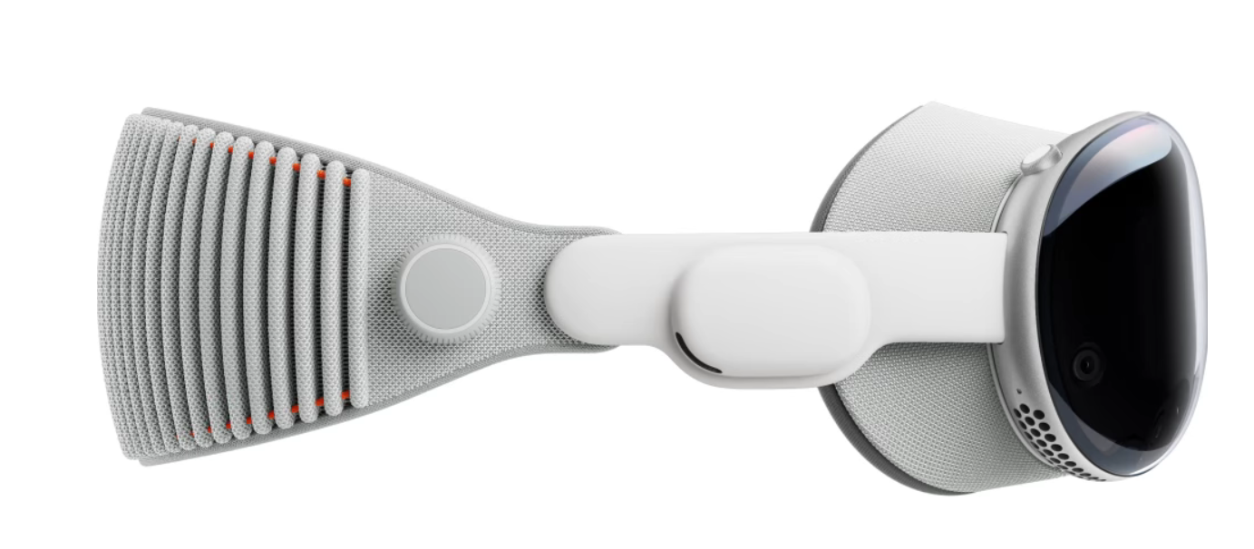
Introduction
In this slide, I will focus on explaining the working principles of VR head-mounted displays (HMDs).
Tracking
Displays
Ergonomics
Optics
Chipset
Notes:
We focus on HMD in this slide.

Slide 8
2

Slide 9
Overall
VR hardware consists of several key components that work together to create immersive environments.
Tracking
Displays
Ergonomics
Optics
Chipset

Slide 10
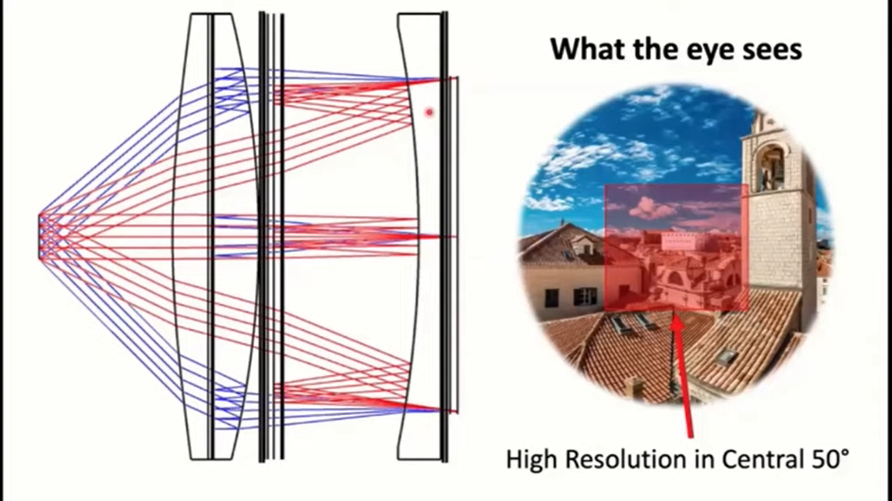
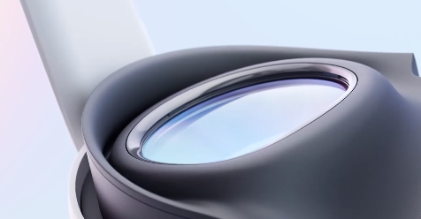
Optics
Optics in XR devices are essential for focusing and directing light from the small displays to the user's eyes. In VR devices, the most common types of optics are Fresnel lenses, Pancake lenses, and Aspherical lenses.
Pancake lenses
Pancake lenses structure
https://www.reddit.com/r/AR_MR_XR/comments/u4fchj/meta_switchable_pancake_creates_high_resolution/
Notes:
Pancake lenses is the most popular.

Slide 11
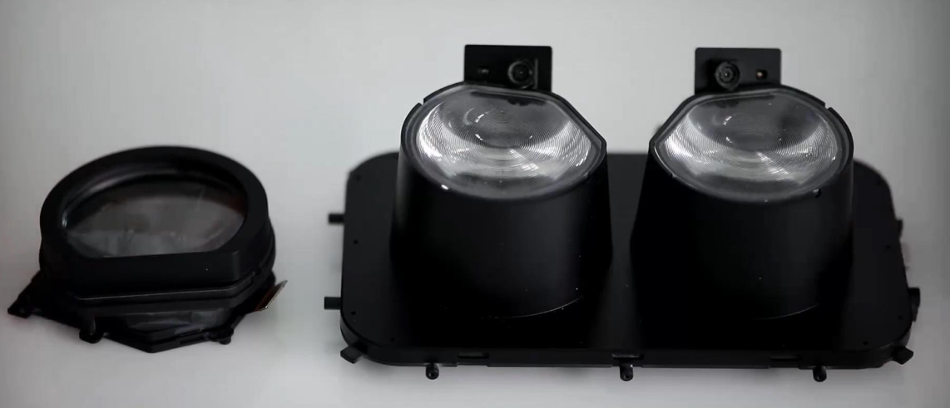
Optics
Pancake lenses are lighter and thinner than other types of lenses, but they suffer from low light efficiency and significant image distortion.
Pancake lenses(Left), Fresnel lense(Right)
https://www.reddit.com/r/OculusQuest/comments/ql4m3p/pancake_lens_vs_fresnel/
Notes:
Pancake lenses are widely adopted by manufacturers due to their ease of production, light weight, and enhanced image quality.
Fresnel lenses are compact lenses and provide a special design that provides high optical efficiency with minimal distortion.

Slide 12
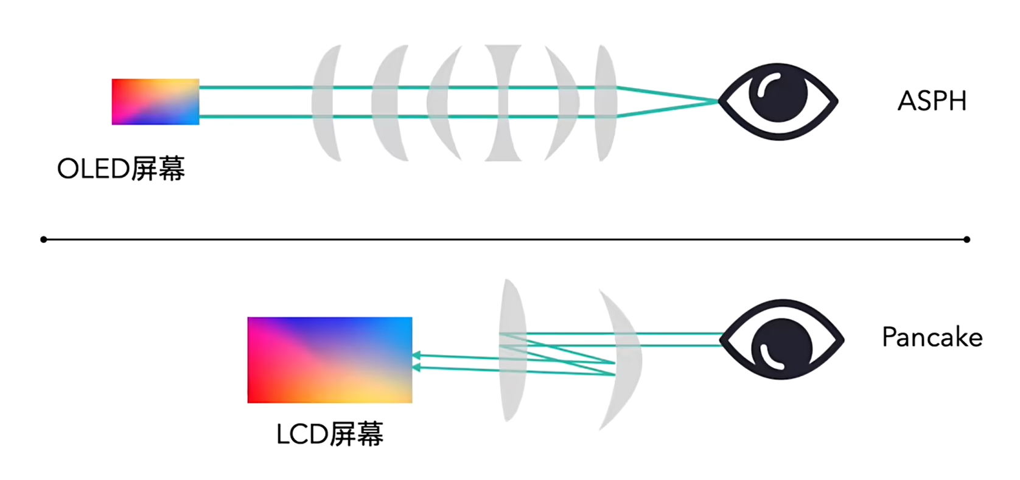
Optics
Pancake lenses are lighter and thinner than other types of lenses, but they suffer from low light efficiency and significant image distortion.
Pancake lenses(Left), Fresnel lense(Right)
https://www.bilibili.com/video/BV1WH4y1B7Xw
Notes:
Aspherical lenses, while offering superior optical efficiency and the best image quality, are highly complex, difficult to manufacture, expensive, and larger in size.

Slide 13
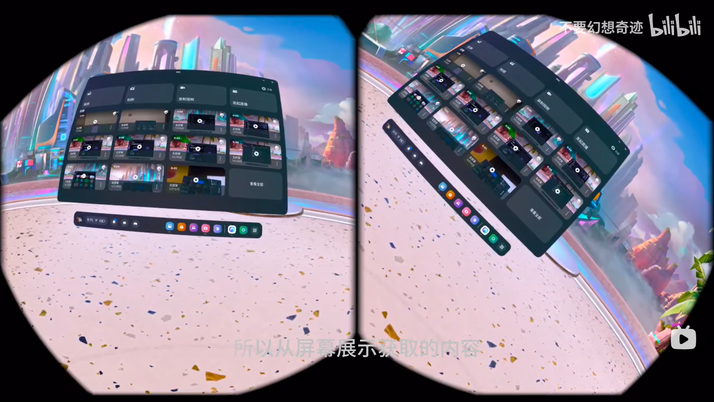
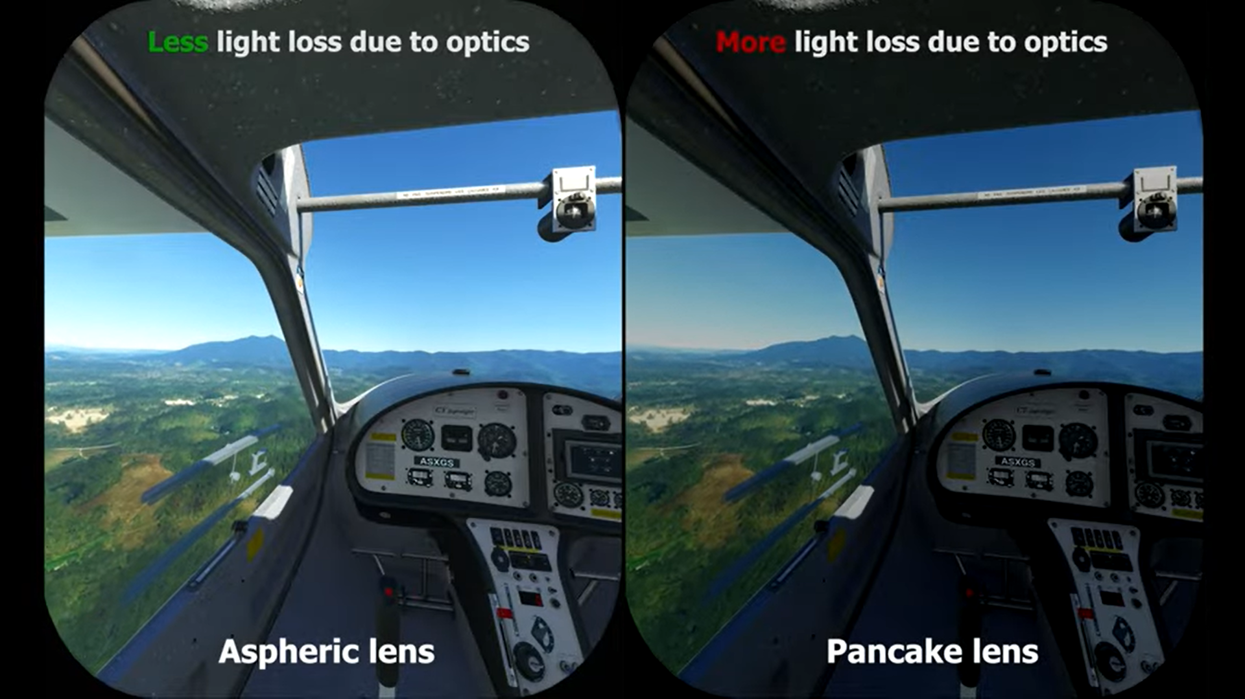
Optics
Pancake lenses will introduce distortions and suffer a significant light loss.
The source image output via ADB
Light loss comparison
https://github.com/Genymobile/scrcpy, https://www.bilibili.com/video/BV1pW421R7Ji
Notes:
Distortions introduced by these lenses can be corrected through software.

Slide 14
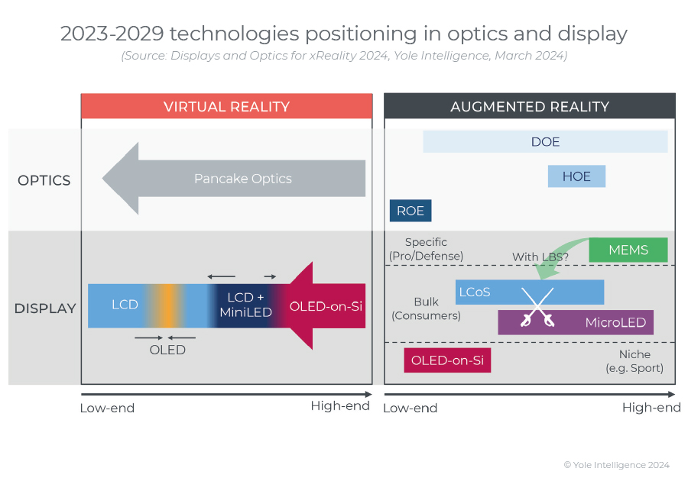
Optics
In Yole view, Pancake lenses have dominated the market.
https://www.yolegroup.com/product/report/displays-and-optics-for-xreality-2024/

Slide 15
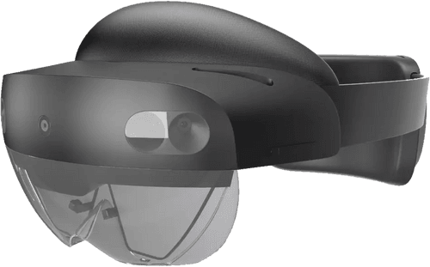
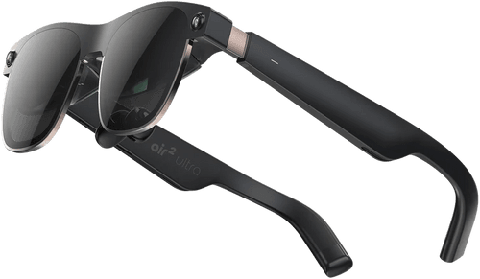
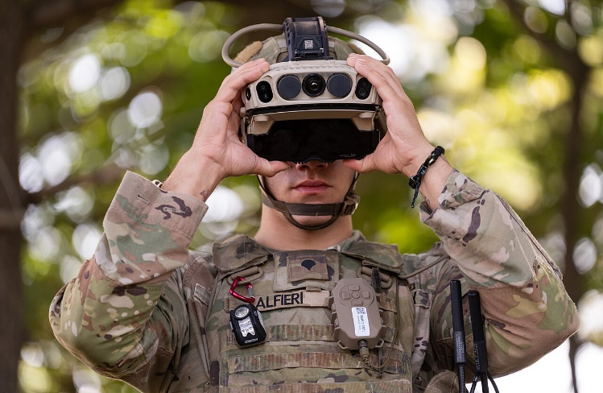
Optics in AR
AR glasses mostly using Birdbath optics and Waveguides optics.
Xreal Air 2 Ultra (BB)
Microsoft Hololens 2 & IVAS 1.2(DOE)
https://www.yolegroup.com/product/report/displays-and-optics-for-xreality-2024/

Slide 16
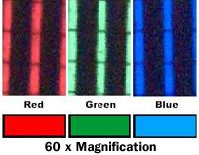
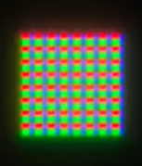
Displays
Displays are the visual interface of a XR device.
The primary display technologies used in XR devices include Liquid Crystal Displays (LCD), Organic Light-Emitting Diodes (OLED), Mini-LEDs (mLED), and Micro-LEDs(μLED)
Notes:
Displays are tiny typically ranging in size up to 7 inches.

Slide 17
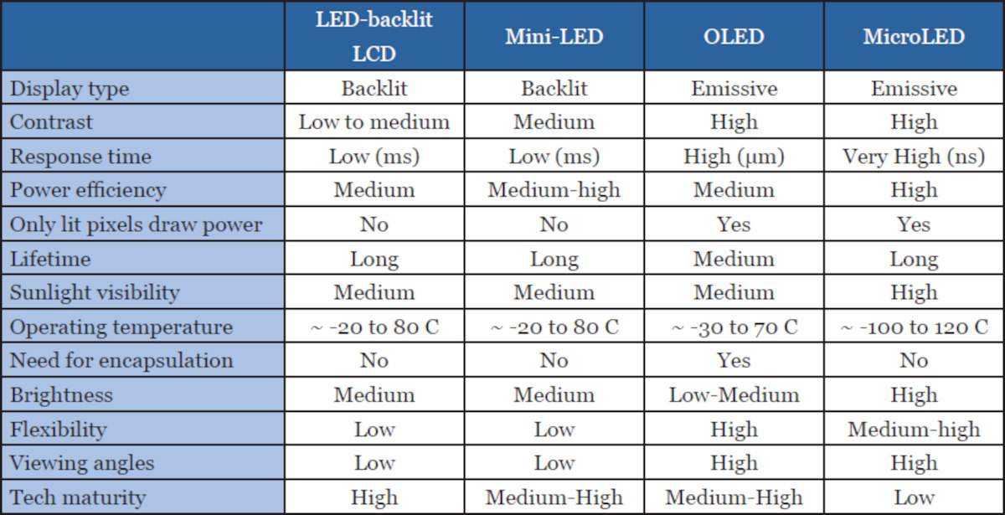
Displays
Displays are the visual interface of a XR device.
The primary display technologies used in XR devices include Liquid Crystal Displays (LCD), Organic Light-Emitting Diodes (OLED), Mini-LEDs (mLED), and Micro-LEDs(μLED)
https://www.oled-info.com/oled-vs-microled-technology-comparison
Notes:
LCD displays can be very bright to overcome the light loss of optics.

Slide 18
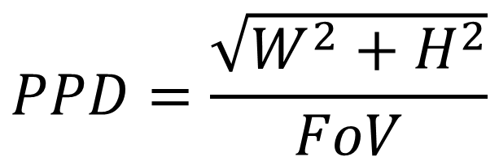
Displays
Resolution in XR devices is more complex than in traditional 2D monitors, and the most critical metric for image quality is angular pixel density (PPD). PPD is determined by both the resolution and FoV, influencing the overall clarity and immersion.
W
$$PPD=\frac{\sqrt{W^{2}+H^{2}}}{FoV}$$
H
FoV

Slide 19
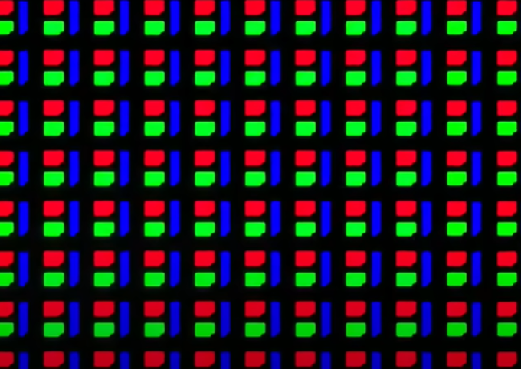
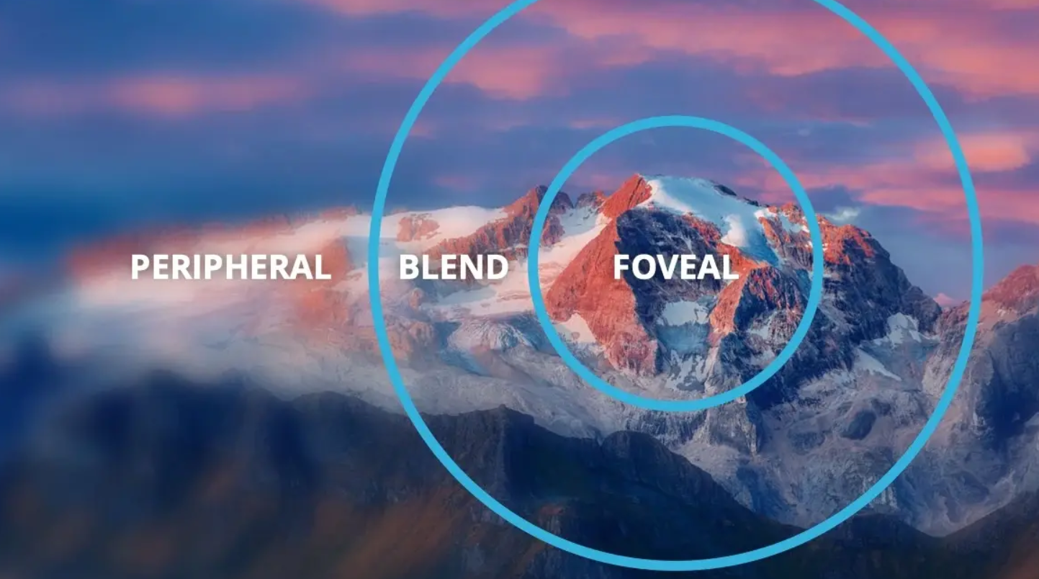
Displays
Displays also present technical challenges that need to be addressed.
Screen door effect
Foveated rendering
Notes:
Displays are tiny typically ranging in size up to 7 inches.
screen door effect
Forveated rendering

Slide 20
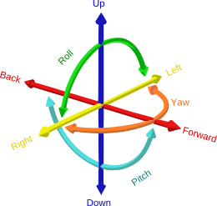
Tracking Systems
The term tracking refers to the process of determining users’ viewpoint position and orientation[1]. Other tracking technologies are not essential for the basic functionality of VR, for example, eye tracking.
Six Degrees of Freedom refers to the six mechanical degrees of freedom of movement of a rigid body in three-dimensional space.
6DoF
https://www.coursera.org/lecture/ar/outside-in-tracking-PplG1
Notes:
The tracking system is a key component of modern VR, directly influencing the quality of immersion.

Slide 21
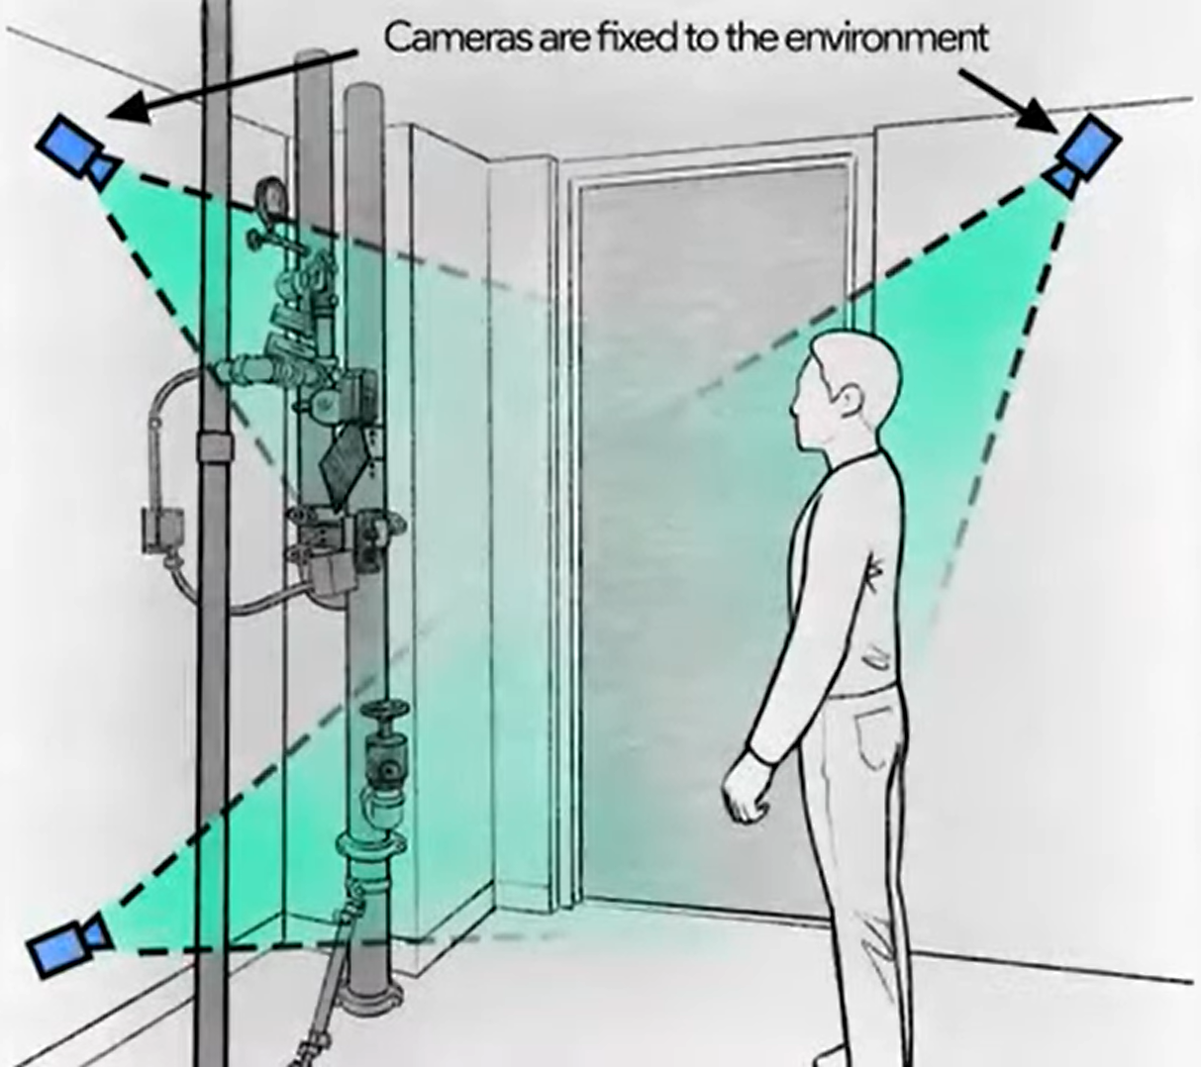
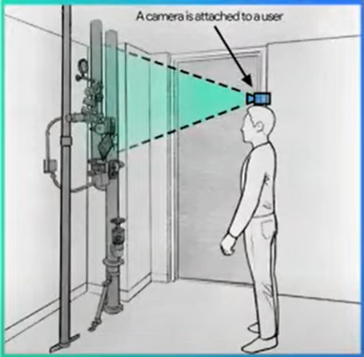
Tracking Systems
Tracking systems are categorized into outside-in and inside-out approaches.
Outside-in and inside-out
https://www.coursera.org/lecture/ar/outside-in-tracking-PplG1
Notes:
Modern tracking technologies increasingly incorporate artificial intelligence (AI), resulting in faster response times and greater accuracy.

Slide 22
Tracking Systems
Tracking systems face numerous challenges.
Need for real-time, accurate tracking
Limited space for sensors
Efficient utilization of all available sensors
Managing the computational power required for processing
Notes:
Qualcomm Snapdragon XR2 can only handle 5 cameras effectively in same time.

Slide 23
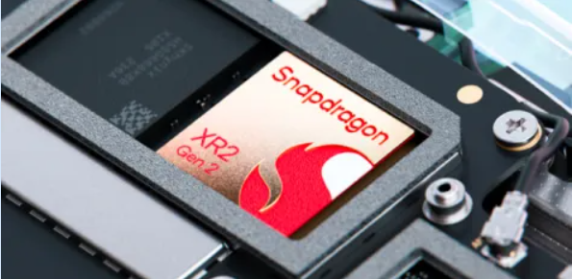
Chipset
Modern mobile devices integrate CPU and GPU into a set of electronic components called a chipset or System on Chip (SoC). Recently, most XR devices have adopted Qualcomm Snapdragon series for their performance and efficiency.

Slide 24




Chipset
Ensuring high-resolution displays with smooth performance is a key challenge in advancing XR technology.
Significant efforts are being made to fully optimize chipset computing power, enhance chipset capabilities, and make use of external computing resources.
Notes:
On one hand, rendering immersive 3D environments in real-time demands significant computational power, which require suffcient computing power on the chipset.This will lead to some issue about heat dissipation, power consumption and so on. On the other hand, maintaining low-latency interactions and spatial tracking requires highly optimized chipset. Ensuring high-resolution displays with smooth performance is the key challenge in the advancement of XR technology.

Slide 25
Research Interest on XR
Design algorithm to overcome distortions introduced by lenses
Enlarge FoV by better rendering algorithm
Real-time 3D rendering optimizations for VR applications
Exploring novel methods for reducing the screen door effect
Spatial mapping and object recognition techniques
Advanced sensor integration for enhanced VR/AR immersion
AI-driven adaptive environments in VR/AR applications
Implementing machine learning to enhance object recognition and tracking
Developing collaborative multi-user mixed reality platforms.
And more…

Slide 26
3

Slide 27
Conclusion
This presentation discussed the key components of VR head-mounted displays (HMDs) and introduced key concepts related to them. Following that, I addressed the challenges in VR development and indicated possible research interests in VR.
The future of VR and XR holds incredible potential, but it also presents unique challenges. Thank you for your attention. I’m now open to any questions or discussions.

Slide 28
THANKS

